Slide 1


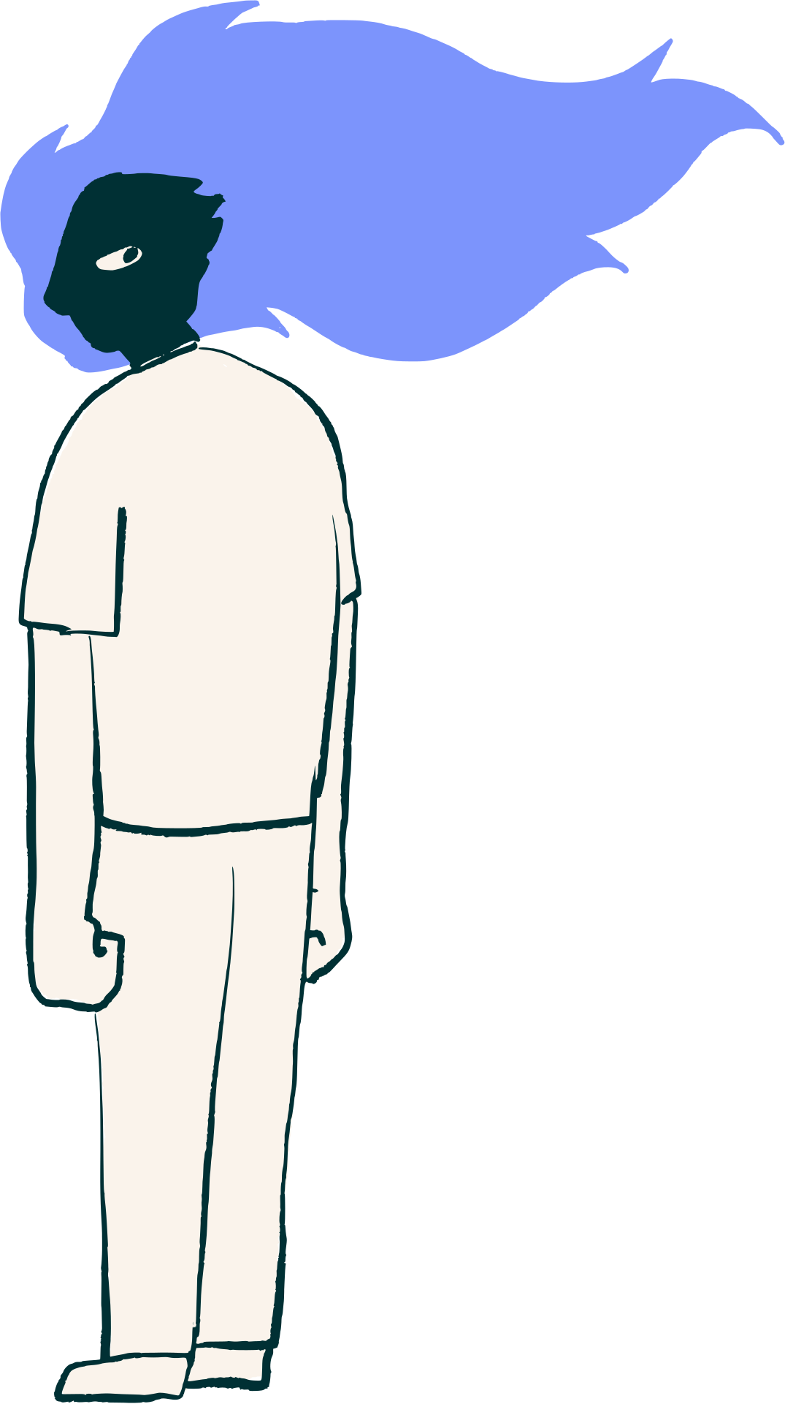
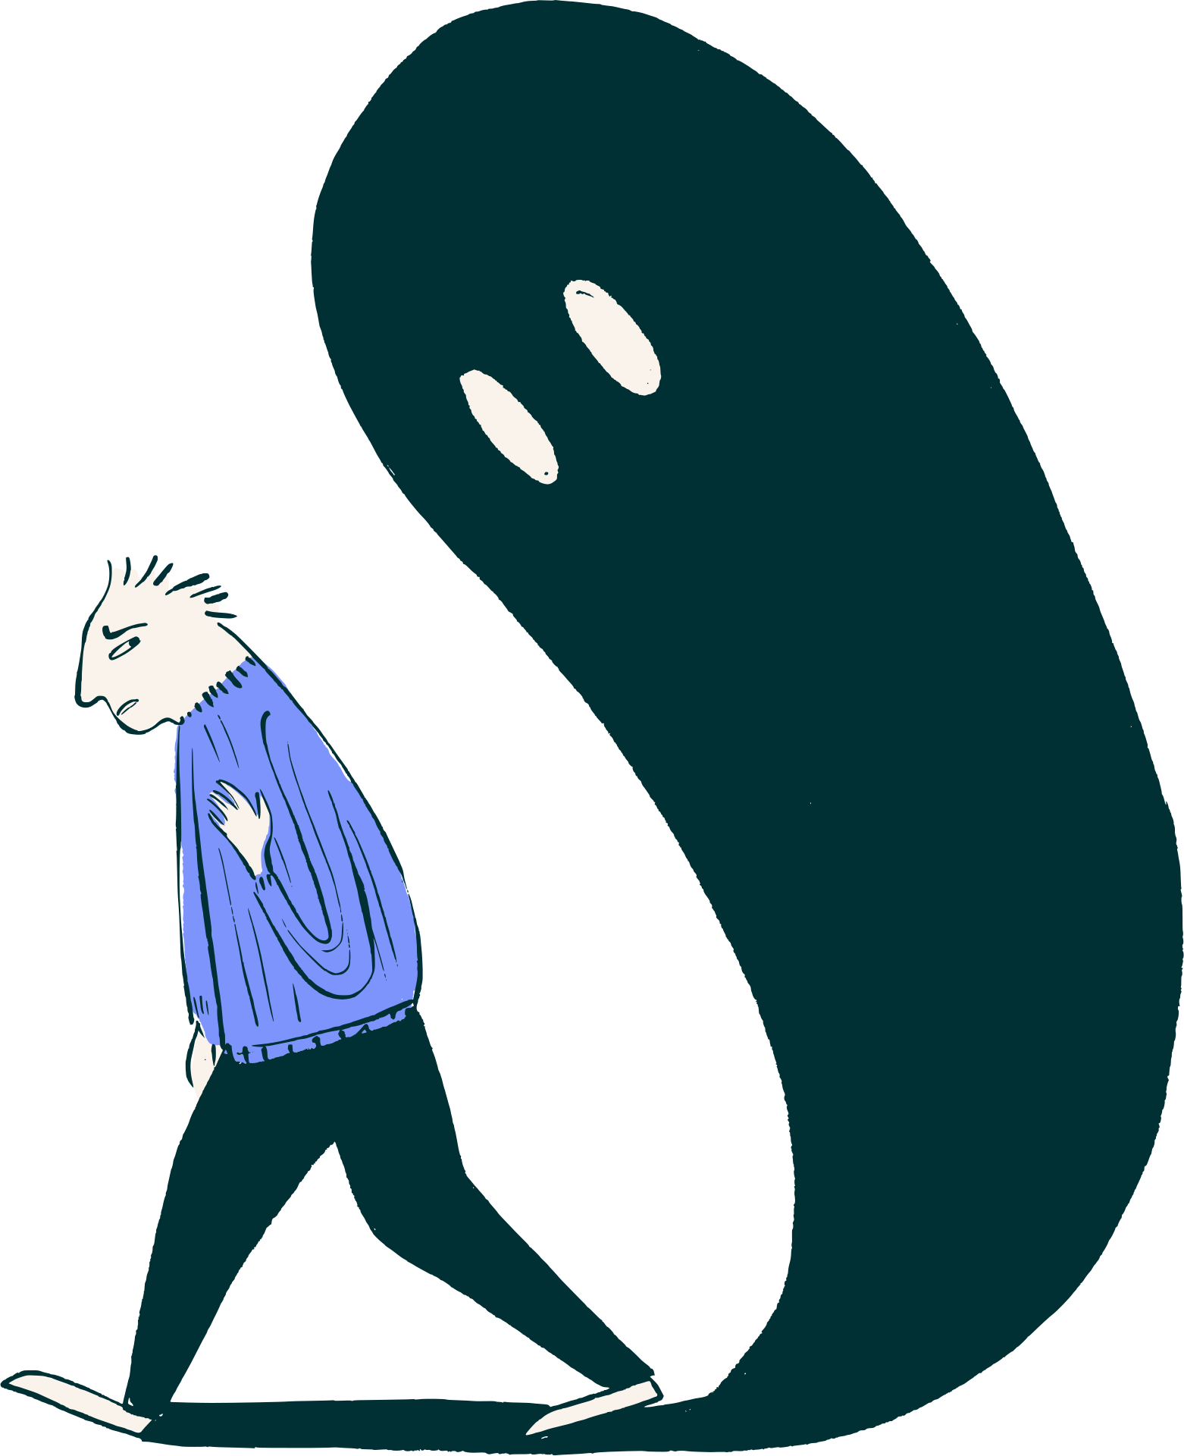
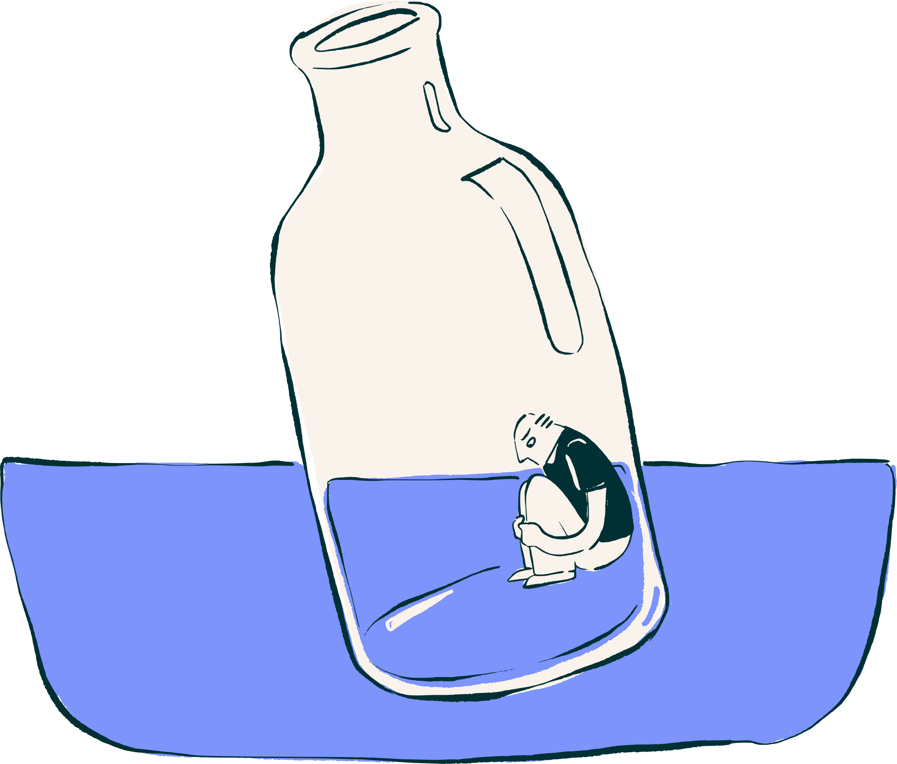
Understanding Anxiety
What everyone should know about anxiety
Presenter name

Slide 2
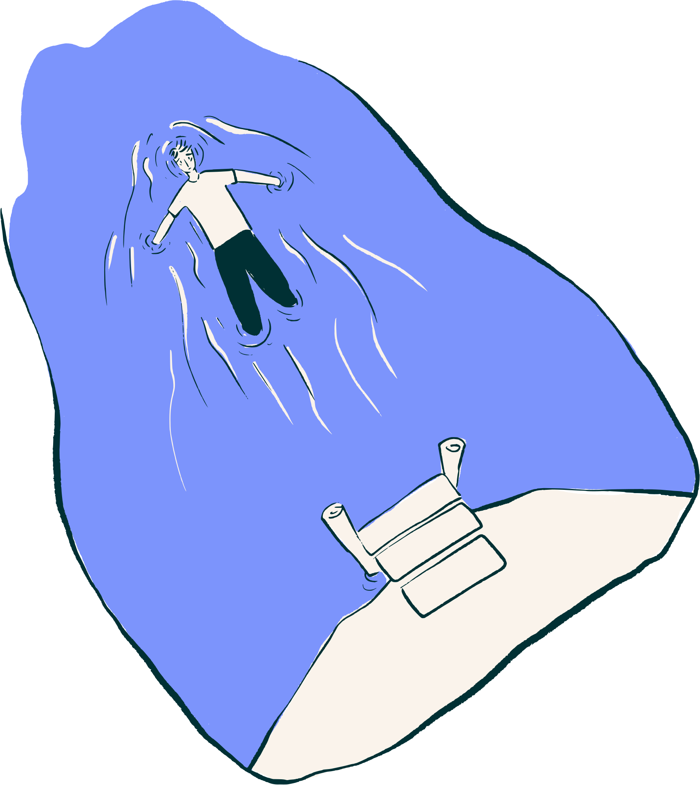

Contents
What is anxiety?
When does anxiety become a problem?
Stress vs. anxiety
Types of anxiety disorders
Diagnosis
Treatment
Understanding Anxiety

Slide 3

Introduction
Prompt the audience with a relatable question about a time they felt nervous or uneasy.
Example: “Have you ever felt nervous before a big test, a presentation, or a doctor’s appointment?”
Understanding Anxiety

Slide 4

What is anxiety?
Include a clear, simple definition of anxiety. Emphasize that it’s normal to feel anxious from time to time.
List examples of everyday situations where people might feel anxious.
Understanding Anxiety

Slide 5

When does anxiety start to become a problem?
Describe the difference between everyday anxiety and clinical anxiety.
Add real-life examples to help show when anxiety starts interfering with daily life, relationships, or health.
Understanding Anxiety

Slide 6
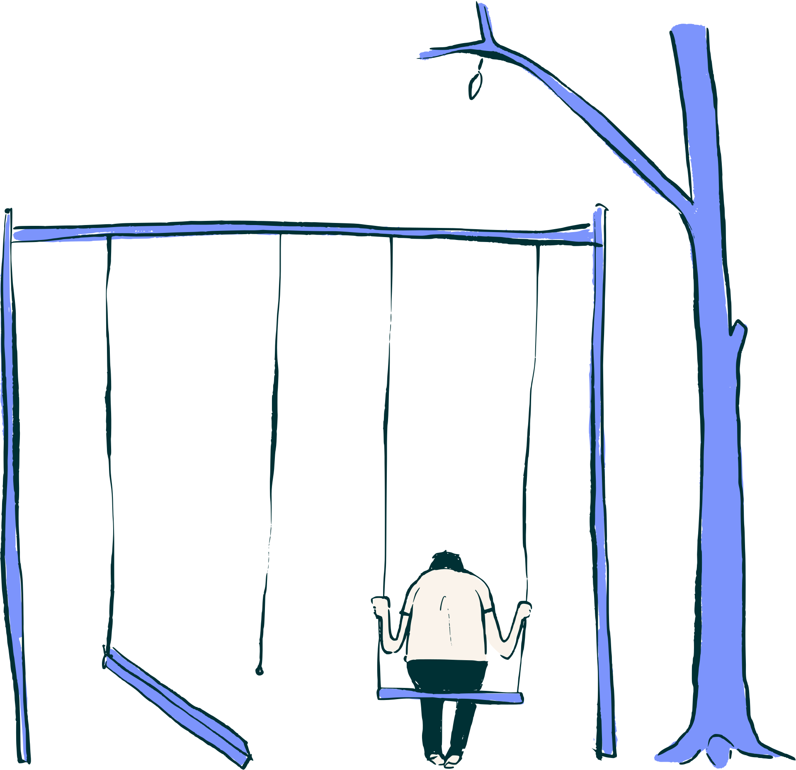
Stress vs. Anxiety
Stress | Anxiety
Write a clear and concise definition here. | Write a clear and concise definition here.
Write a clear and concise definition here. | Describe a defining characteristic here.
Write a clear and concise definition here. | Add examples of physical signs of anxiety.
Understanding Anxiety

Slide 7

301
Million
People worldwide are affected by anxiety disorders
Supporting details about the statistic and its source here
Understanding Anxiety

Slide 8
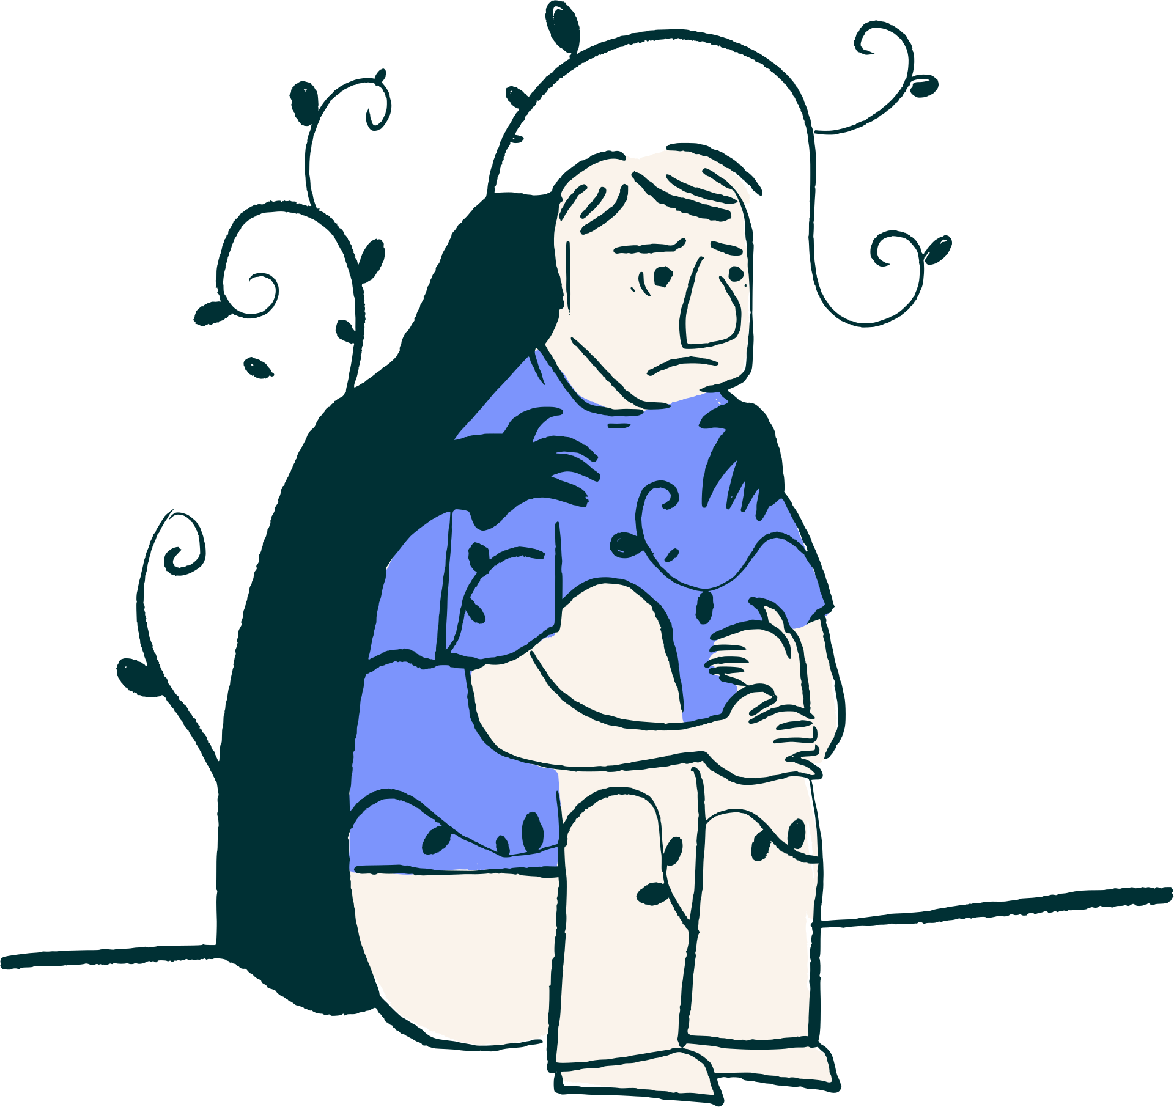
Types of
anxiety disorders
Generalized anxiety disorder
Panic disorder
Social anxiety disorder
Highlight the defining traits and how it presents.
Highlight the defining traits and how it presents.
Highlight the defining traits and how it presents.
Understanding Anxiety

Slide 9
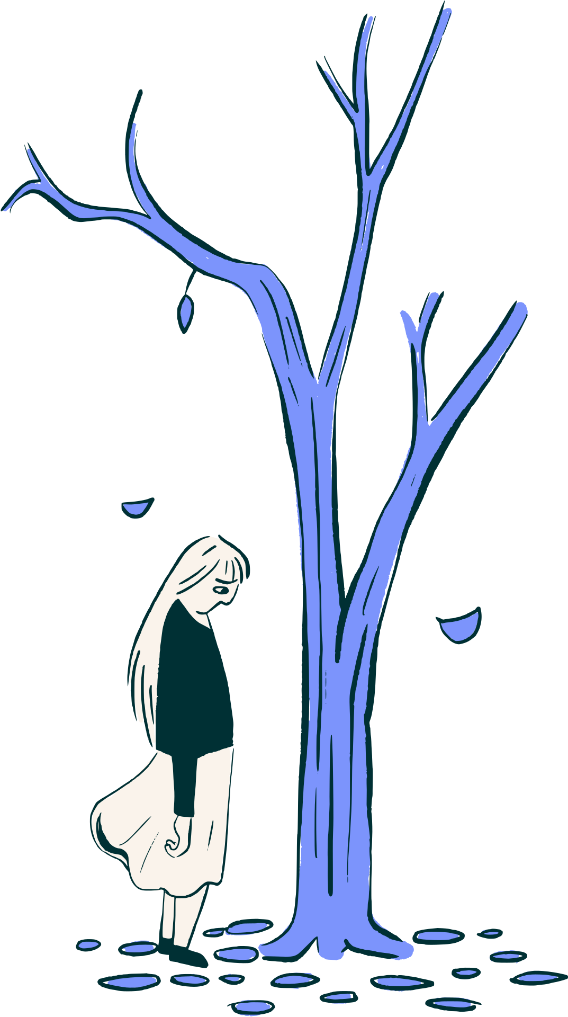
Statement 1
Myths vs. Facts
Add supporting details here.
Statement 2
Add supporting details here.
List common beliefs about anxiety and have the audience identify which are myths and which are facts. Use these to support your discussion.
Statement 3
Add supporting details here.
Understanding Anxiety

Slide 10

Diagnosis
Explain that anxiety is diagnosed by a qualified mental health professional.
Describe the process, which may include a clinical evaluation, a discussion of symptoms, and standardized assessments.
Understanding Anxiety

Slide 11

Treatment
Therapy
Prescribed medication
Support groups
Explain how this approach can support someone living with anxiety.
Explain how this approach can support someone living with anxiety.
Explain how this approach can support someone living with anxiety.
Understanding Anxiety

Slide 12
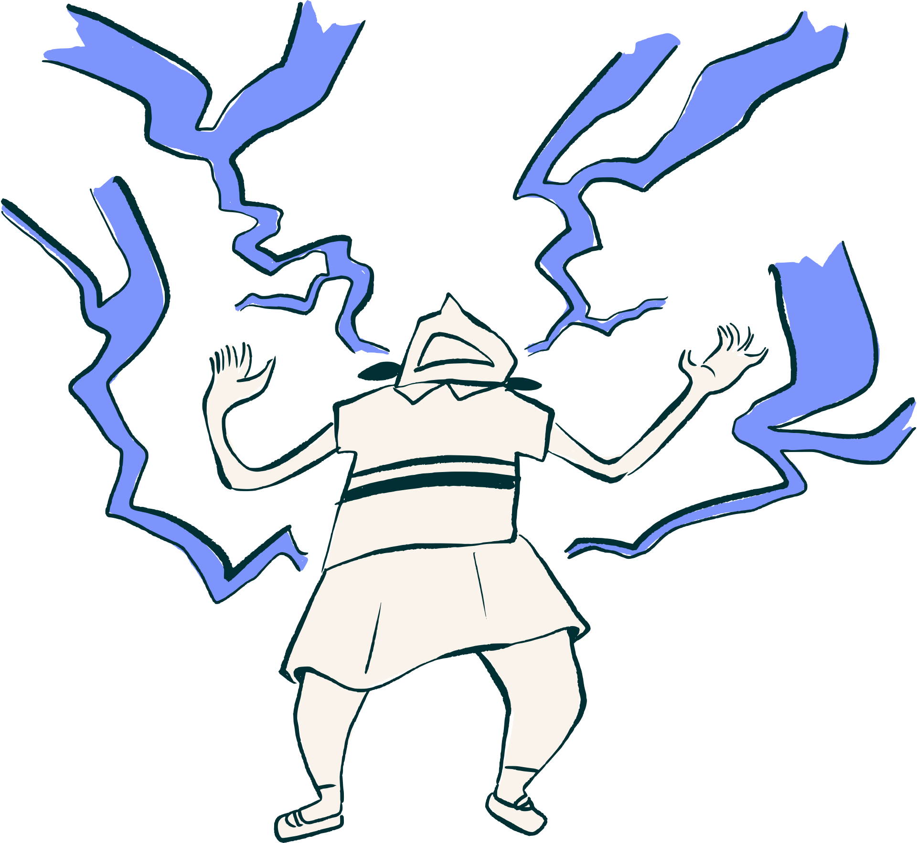
What is anxiety?
A recap
Highlight the key concept covered here.
When does anxiety become a problem?
Highlight the key concept covered here.
Types of anxiety disorders
Highlight the key concept covered here.
Diagnosis and treatment
Highlight the key concept covered here.
Understanding Anxiety

Slide 13
Organization here
Where to get help
Helpline or number here
Organization here
Helpline or number here
Organization here
Helpline or number here
Understanding Anxiety

Slide 14
Resource Page
Use these in your presentation. Delete or hide this page before presenting.
Fonts
Design Elements / Icons
This presentation template
uses the following free fonts:
TITLES:
Cormorant Garamond
BODY TEXT:
Open Sauce
You can find these fonts online too.
Colors
#7C94FC
#C5D0FF
#FAF3EB
#FFFFFF

Slide 15

Credits
This presentation template is free for everyone to use, thanks to the following:
for this presentation template
Pexels, Pixabay, Sketchify
for the photos, graphics, and elements
Happy designing!

